Slide 1
Megacities
A snap-shot of urban development

Slide 2

Definition:
A megacity has two quantitative characteristics:
More than 2,000 people per square mile
More than 1,000,000 people within city limits

Slide 3
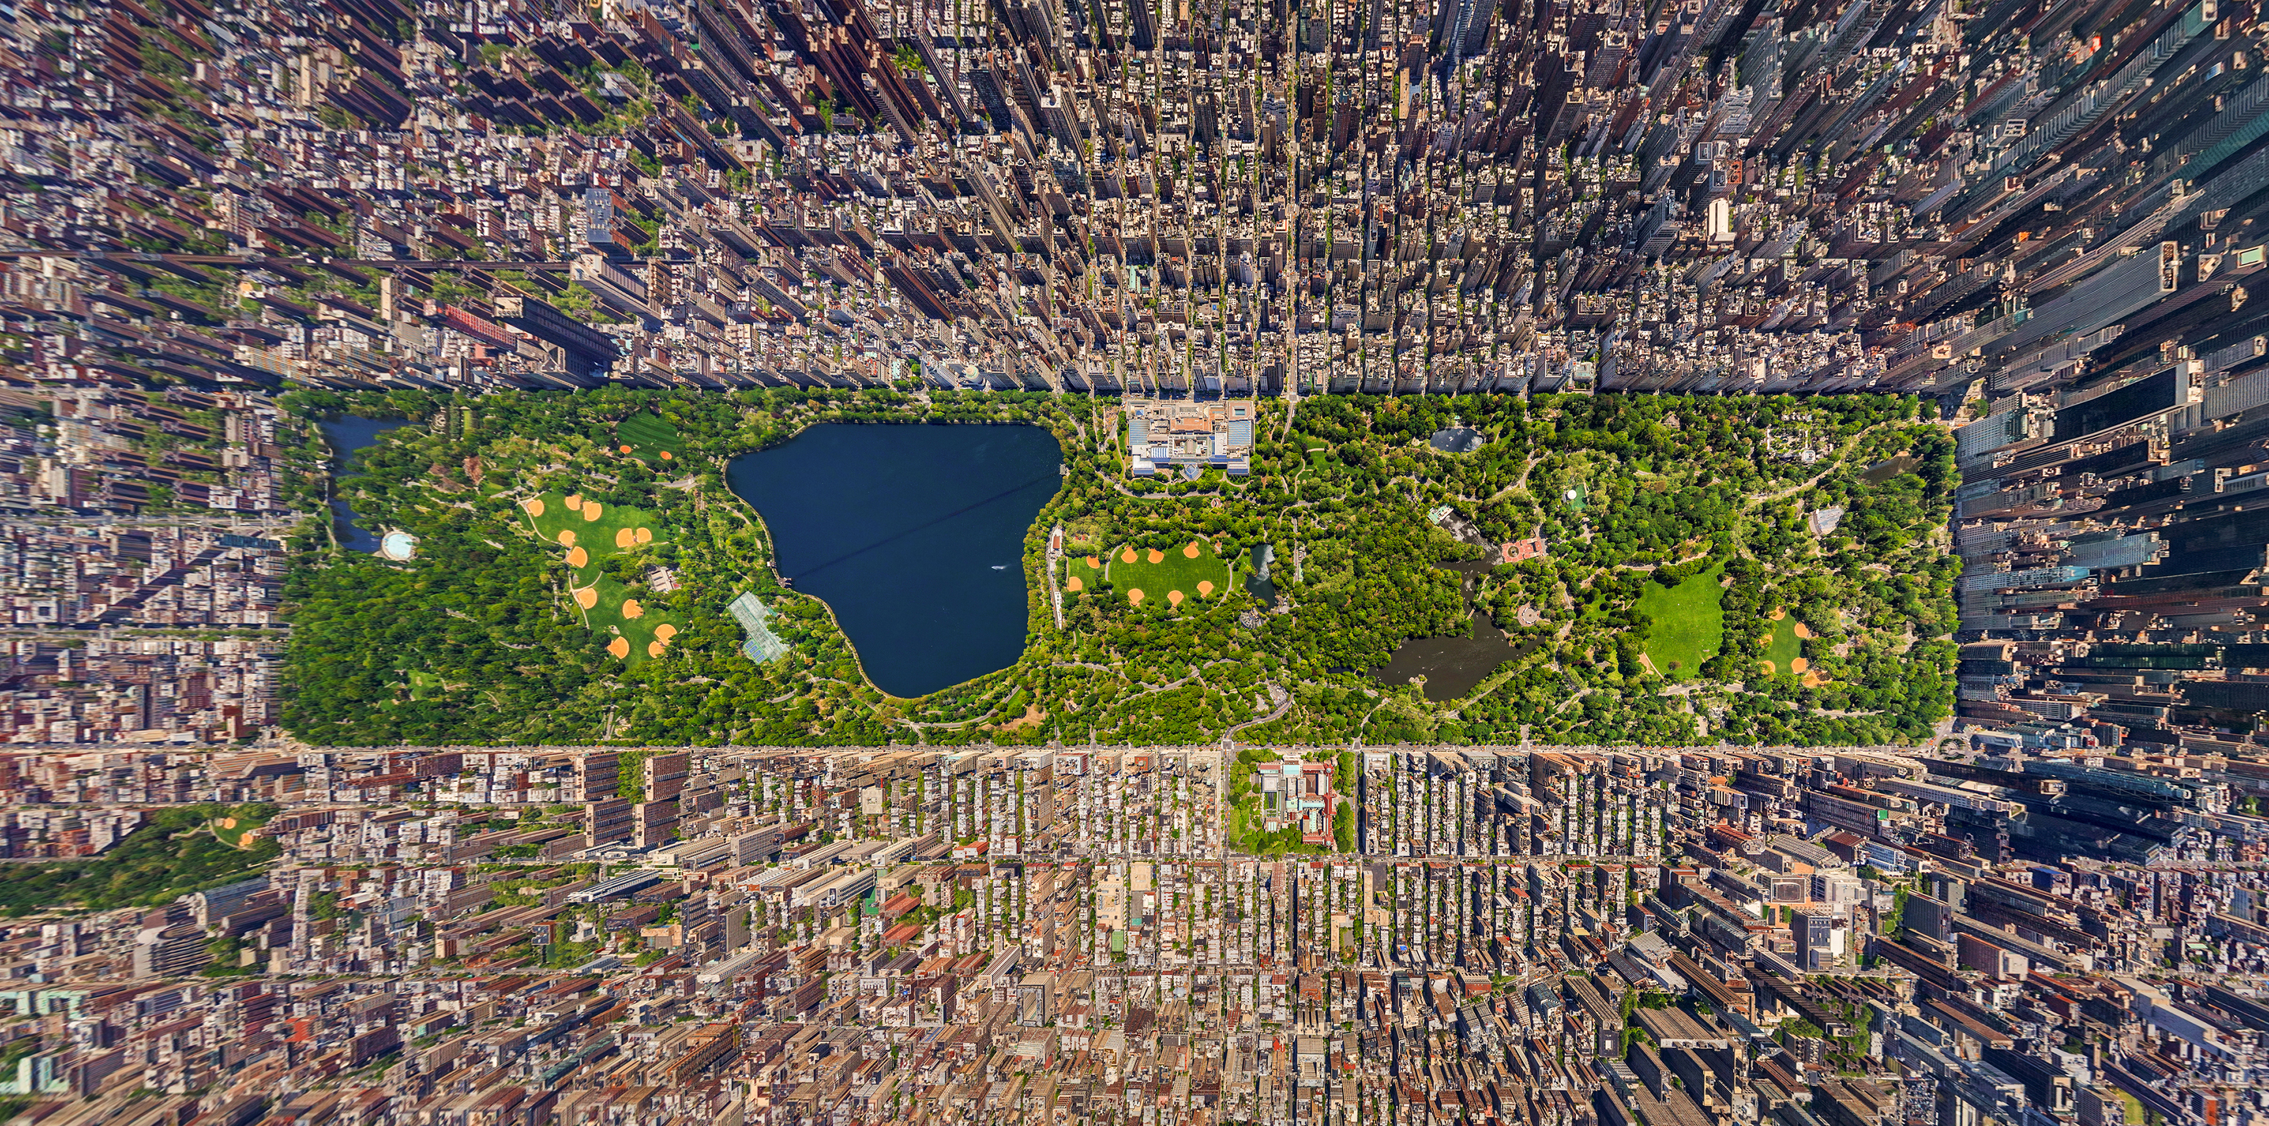





Our cities: the top 5
1
2
3
New York
Los Angeles
Chicago
4
5
Houston
Phoenix

Slide 4

Measures
Economic
Median Household Income, Unemployment Rate, Cost of Living, Poverty
Demographic
Population Density, Median Age, Education Level
Housing
Median Home price, Rental Price (Median Rent), Homeownership Rate
Quality of Life
Crime Rate, Air Quality Index, Commute time, Walkability Score

